Slide 1
ORIE 5980 M.Eng. Project
Evening Prelims Scheduling
Advisor: Professor David Shmoys
Students: Yi He, Mingjie Lyu ,
Ryan Walker, Jingzhuo Xu

Slide 2

Study of Current Scheduling Process
AY1415 Survey results (from Cornell Registrar’s Office)
Did the scheduled evening prelims take place as planned?
Was the schedule of those evening prelims well timed?
Take away:
Combined with course enrollment data, we found that a larger number of conflicts still exists, though most professors seem to be OK with current schedule.
Current schedule was not very satisfying enough to accommodate course progress and important date like holiday and drop date.
The prelim dates are not well spaced, some too early to semester beginning, some to close to semester end, and some too close to each other.
Operational Research and Information Engineering

Slide 3
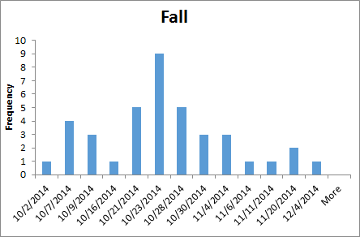
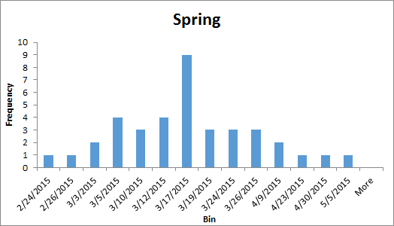
Study of Current Scheduling Process
2014-2015 prelim schedule
One-Prelim Courses
Operational Research and Information Engineering

Slide 4
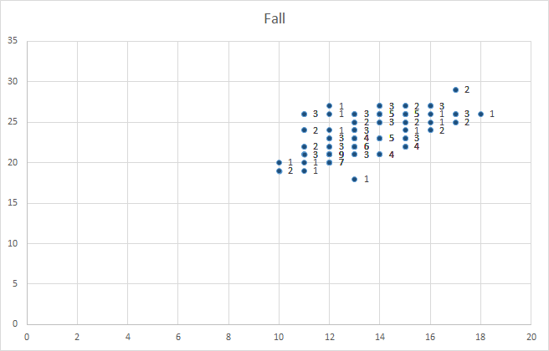
Study of Current Scheduling Process
2014-2015 prelim schedule
Two-Prelim Courses
Operational Research and Information Engineering

Slide 5
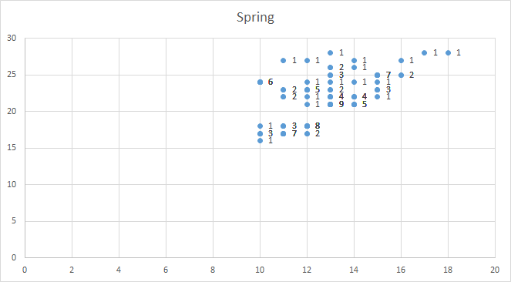
Study of Current Scheduling Process
2014-2015 prelim schedule
Two-Prelim Courses
Operational Research and Information Engineering

Slide 6
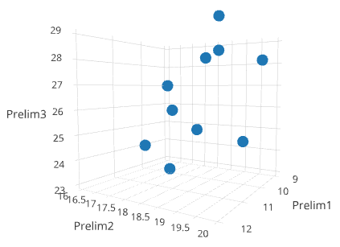
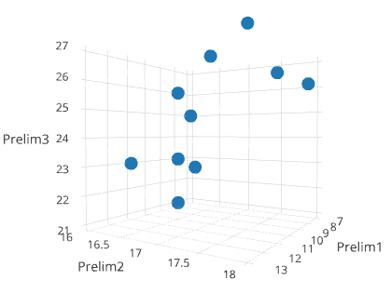
Study of Current Scheduling Process
2014-2015 prelim schedule
Three-Prelim Courses
Fall
Spring
Study of current schedule gave us insight on cause of conflicts and potential for improvements.
Operational Research and Information Engineering

Slide 7
Study of Current Scheduling Process
Goals for the Second Survey:
A bigger sample space.
More detailed questions about professors’ concern.
Learn about professors’ preferred prelim schedule, based on course progress and enrollment conflicts.
To solve the spacing problem, we asked how important professors think it is for their prelims to be equally spaced across the semester.
Operational Research and Information Engineering

Slide 8
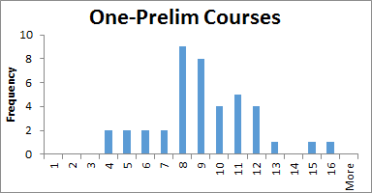
Step Further: Our own Survey & Result
Professors’ ideal prelim schedule
Weeks
Operational Research and Information Engineering

Slide 9
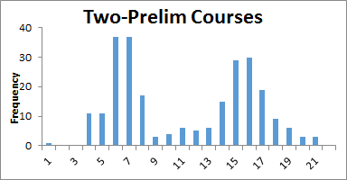
Step Further: Our own Survey & Result
Professors’ ideal prelim schedule
Weeks
Operational Research and Information Engineering

Slide 10
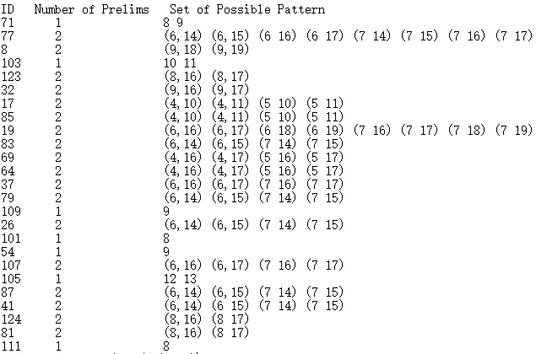
Step Further: Our own Survey & Result
Pattern Generation:
Based on the feedback, we generated prelim patterns, which were directly used as input in our final IP model.
Operational Research and Information Engineering

Slide 11
Step Further: Our own Survey & Result
Professors’ None-quantitative preference (Sample):
The first prelim should be before the drop deadline.
No prelims immediately before or after long vacations like spring and fall break.
Last prelims shouldn’t be too close to the final.
Two highly correlated large courses shouldn’t have prelims in same evening due to the amount of conflicts
Interval between two prelims should be long enough to fit course progress
Prelims schedule should adjust according to students’ special need like recruitment season and religious holidays.
……..
Operational Research and Information Engineering

Slide 12
Course Data Analysis
Course Indexing
Generate a unique index for each distinct course.
W - Co-meet: an undergraduate level course and a graduate course that have class and prelim together
C - Cross-list: courses offered by different department that meet together and shares the same course id
B - both
Assumption
Half-term courses: treat them as full-semester courses
Enrollment information
Assign an unique id to each student and each course
Obtain the matrix recording the number of overlaps for any pair of courses.
Operational Research and Information Engineering
Notes:
use course type (C, B, W) to create course index
use data from registra to evaluate current schedule
5580 and 5581
apart from the survey data, we also get enrollment information from registra

Slide 13
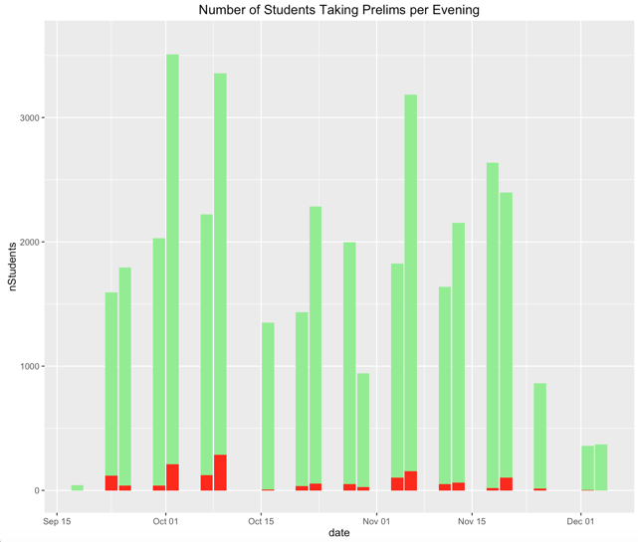
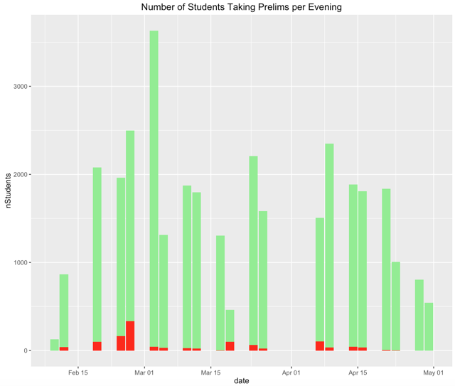
Course Data Analysis
Evaluating Current Schedule
2014 Fall Semester 2015 Spring Semester
1,478 Conflicts 1,203 Conflicts
Operational Research and Information Engineering
Notes:
1478， 1203

Slide 14
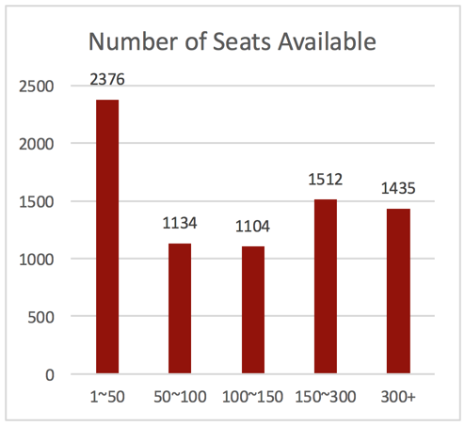
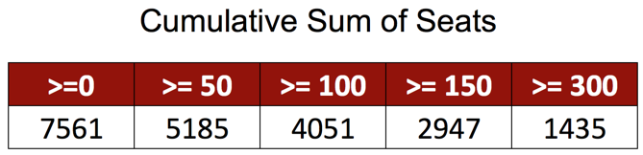
Course Data Analysis
Capacity Analysis
The capacity is limited for every time slot.
Current Capacity Constraint is 3,000 every night
There’s a potential to relax this limit to 5,000
Operational Research and Information Engineering
Notes:
half seats

Slide 15
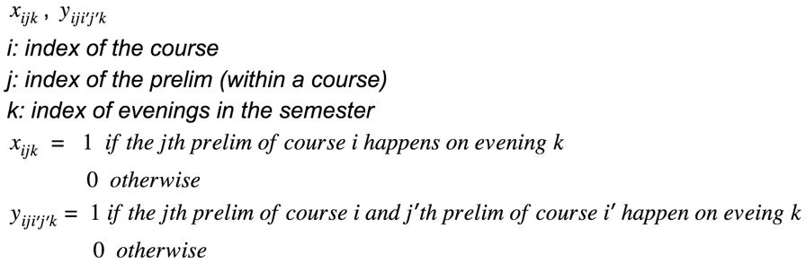
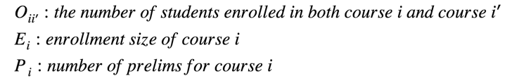
Linear Programming Formulation
Decision Variables
Parameters
Operational Research and Information Engineering

Slide 16

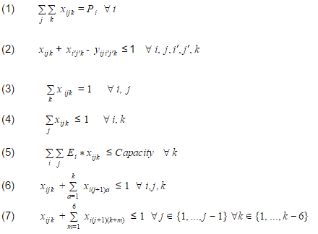
Linear Programming Formulation
Objective Function
Constraints
Operational Research and Information Engineering
Notes:
(1) For each course, the correct number of prelims are scheduled
(2) Link decision variables together
(3) Within a course, each prelim is scheduled exactly once
(4) For each course, all prelims cannot be scheduled for the same day
(5) For every night, the number of students taking the prelim cannot exceed the seats capacity
(6) For each course, prelims must be scheduled in proper sequence
(7) For a pair of prelims within a given course, there must be at least three week’s separation

Slide 17
Linear Model
Model Limitations
The problem was very large, and the run time was very long
2 million variables
6 million constraints
So many variables and constraints made it difficult to guarantee all constraints were being enforced correctly
Are we optimizing the right problem?
Is 100 conflicts much better than 300 if the schedule is dramatically different than before?
Lack of flexibility
It is hard to adjust the constraints and objective to satisfy diverse requests from professors. Complexity grows very quickly
Operational Research and Information Engineering
Notes:
Linear Model Input file: reference worksheet, and overlap matrix only
Combinatorial Model Input file: reference worksheet, overlap matrix, and schedule pattern text file

Slide 18
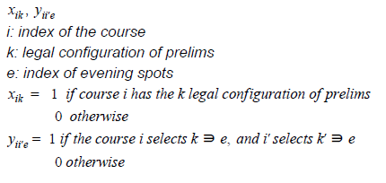


New Integer Programming Model
Model formulation
Decision Variables
Parameters
Operational Research and Information Engineering

Slide 19

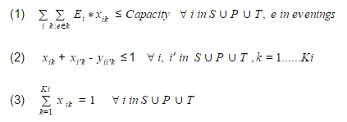
New Integer Programming Model
Model formulation
Objective Function
Constraints
Operational Research and Information Engineering

Slide 20
New Integer Programming Model
Original Schedule Adjusted Plus/Minus 1 Evening
Suppose course has prelims scheduled on e₁ and e₂
Now consider the following possible configurations
Prelim 1 Prelim 2
e₁ - 1 e₂ - 1
e₁ e₂
e₁ + 1 e₂ + 1
Minor change from original schedule, same spacing kept
Operational Research and Information Engineering

Slide 21
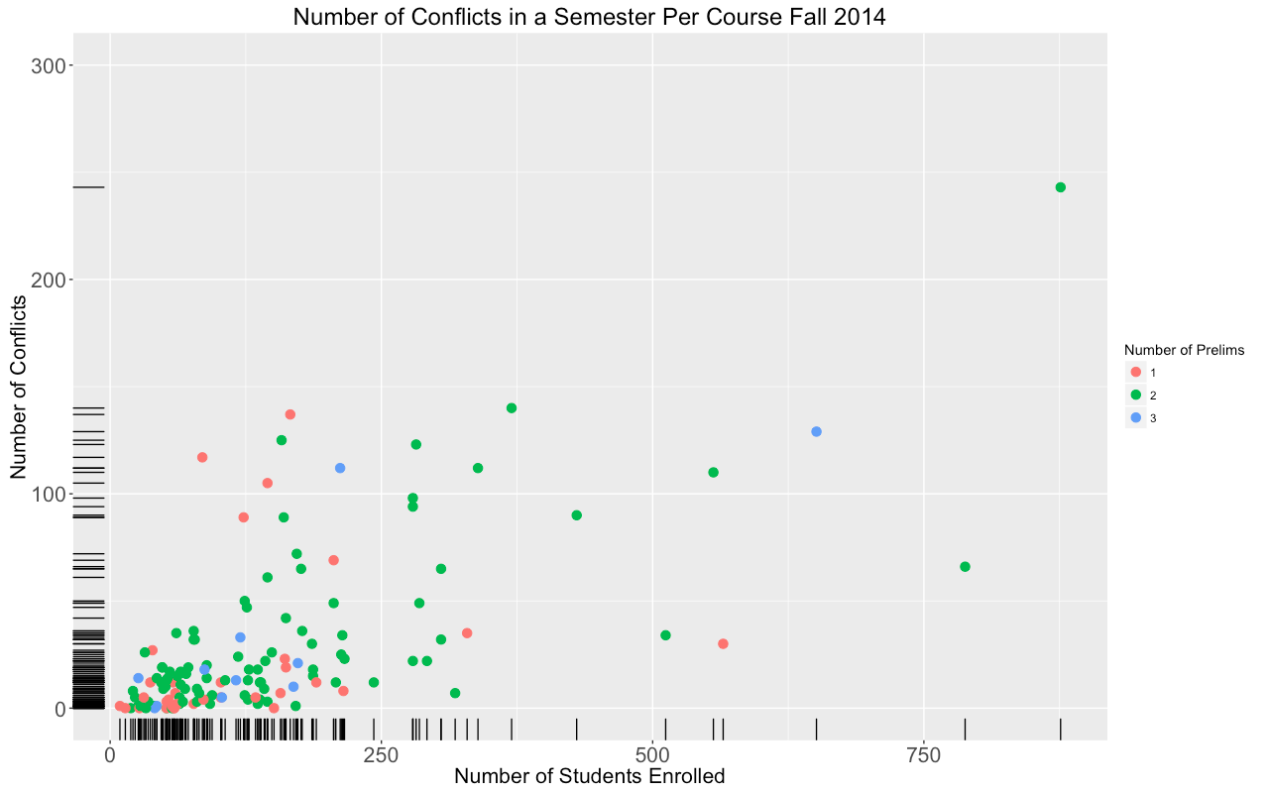
New Integer Programming Model
Operational Research and Information Engineering

Slide 22
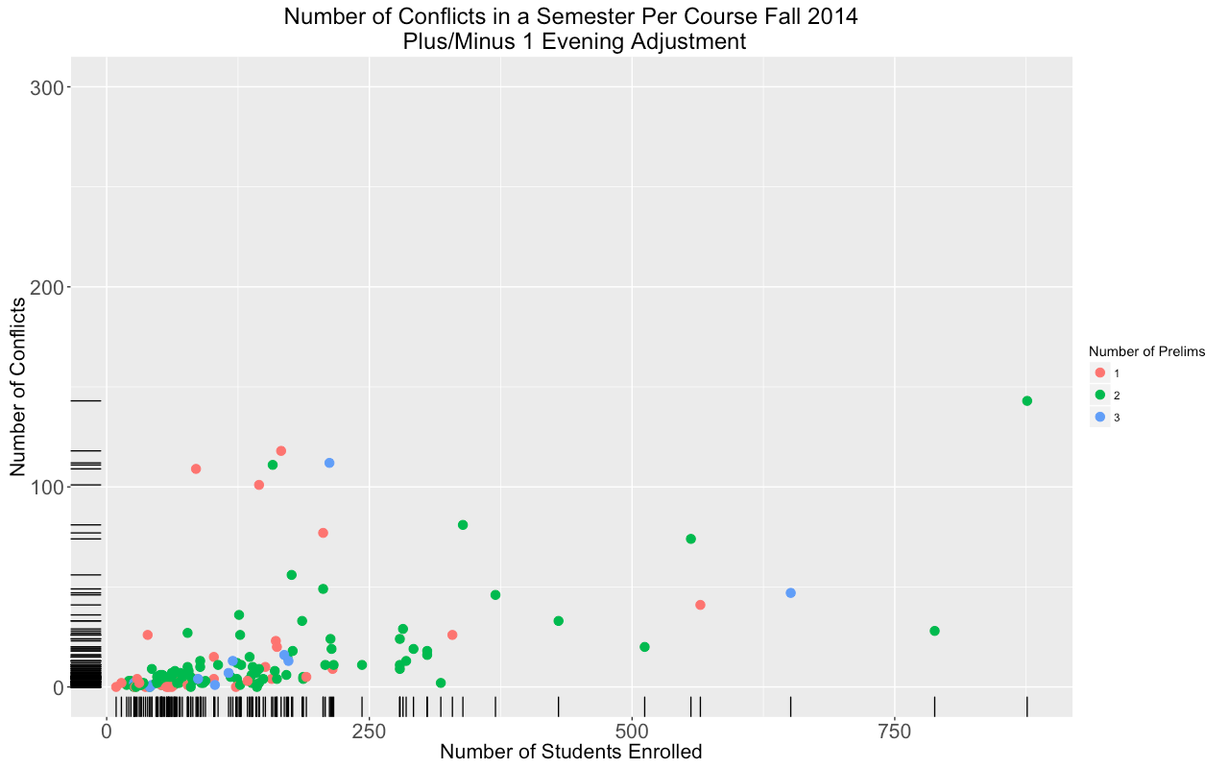
New Integer Programming Model
Operational Research and Information Engineering

Slide 23
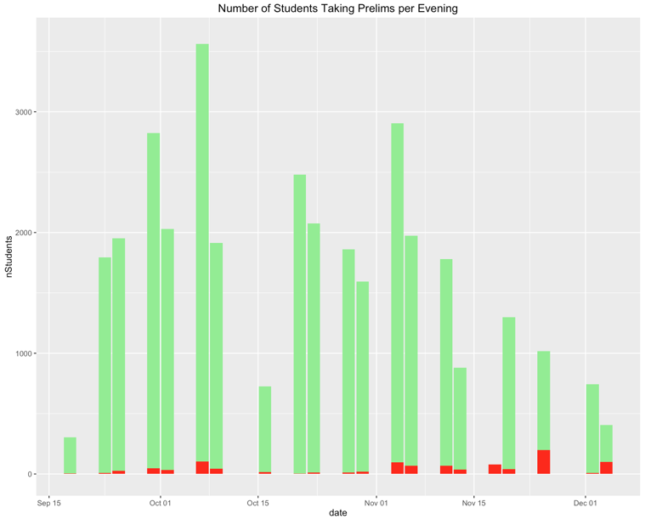
New Integer Programming Model
2014 Fall Semester with Plus/Minus One Evening
Operational Research and Information Engineering

Slide 24
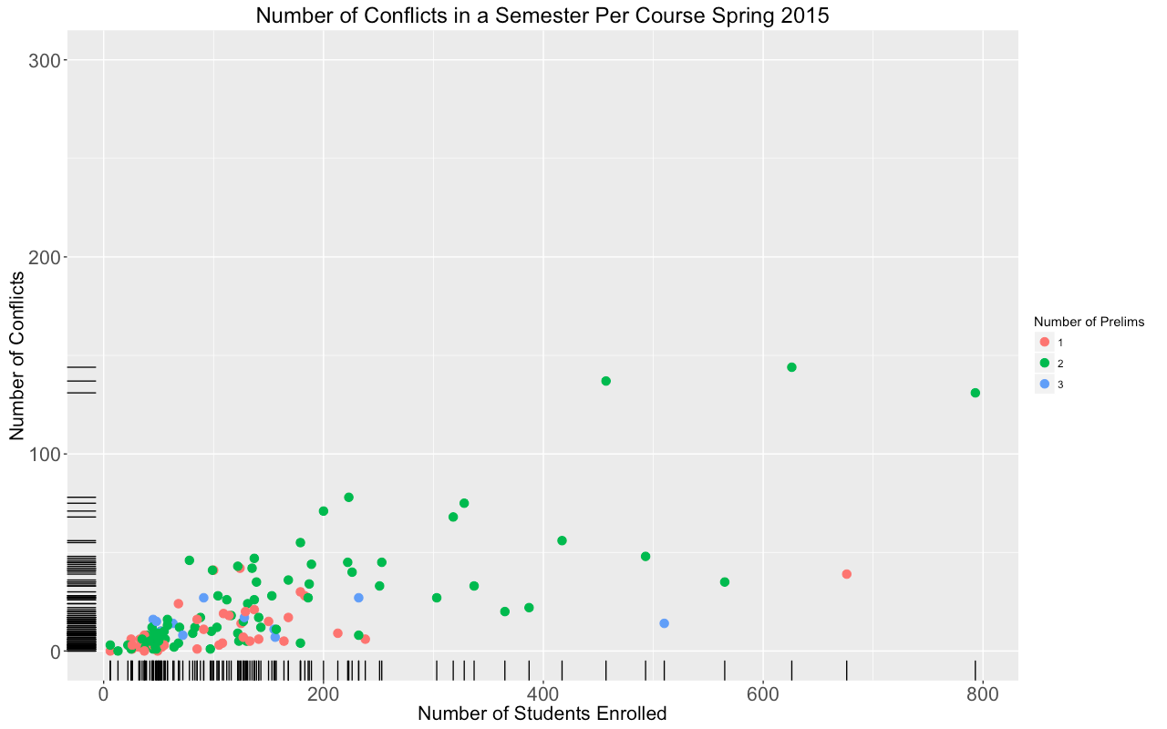
New Integer Programming Model
Operational Research and Information Engineering

Slide 25
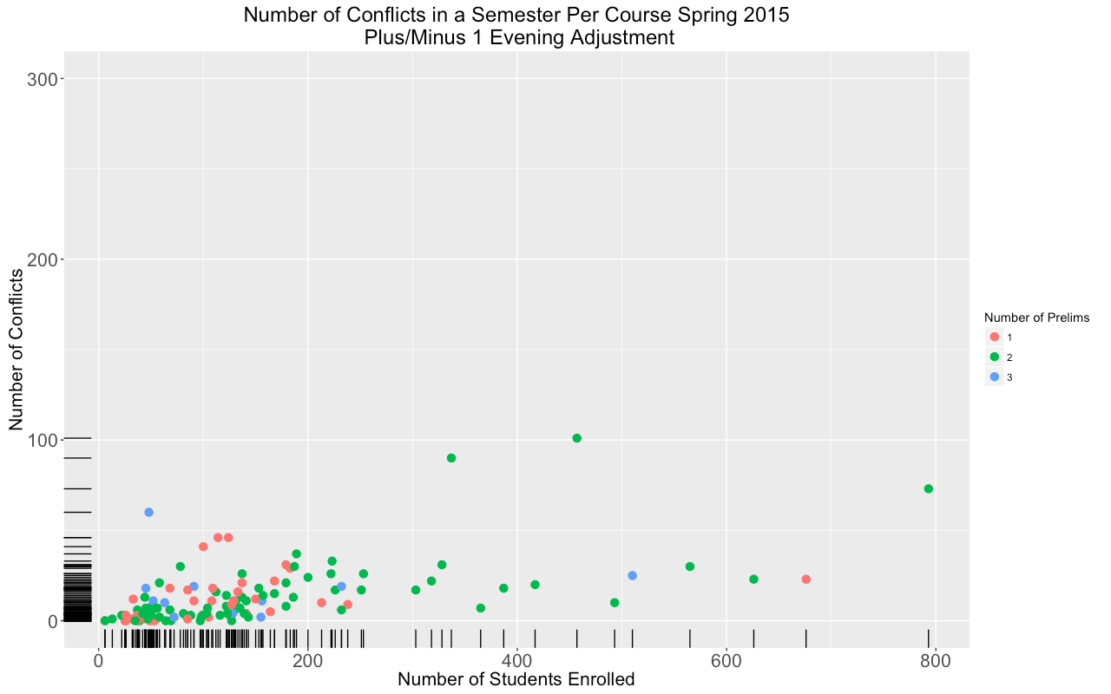
New Integer Programming Model
Operational Research and Information Engineering

Slide 26
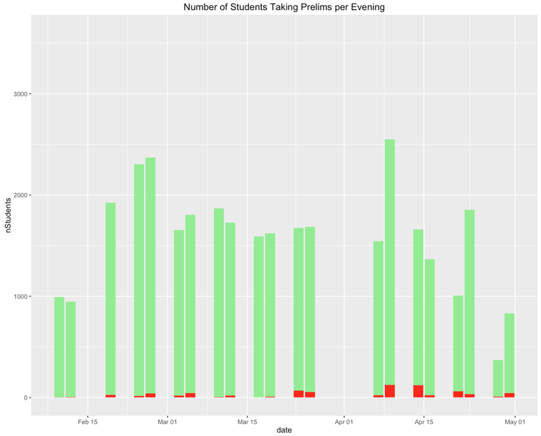
New Integer Programming Model
2015 Spring Semester with Plus/Minus One Evening
Operational Research and Information Engineering

Slide 27
New Integer Programming Model
Original Schedule Plus/Minus 1 Evening Relaxed
Suppose course has prelims scheduled on e₁ and e₂
Now consider the following possible configurations
Prelim 1 Prelim 2
Slightly bigger change from original schedule
e₁ - 1 | e₂ - 1
e₁ - 1 | e₂
e₁ | e₂ - 1
e₁ | e₂
e₁ | e₂ + 1
e₁ + 1 | e₂
e₁ + 1 | e₂ + 1
Operational Research and Information Engineering

Slide 28
New Integer Programming Model
Operational Research and Information Engineering

Slide 29
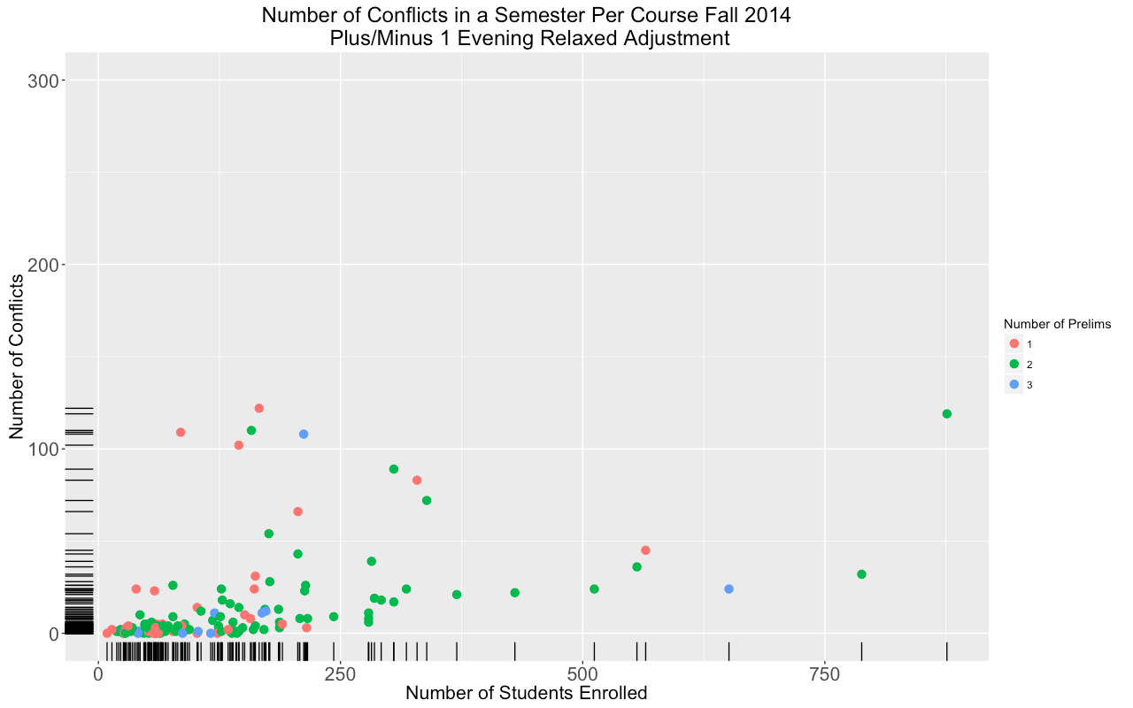
New Integer Programming Model
Operational Research and Information Engineering

Slide 30
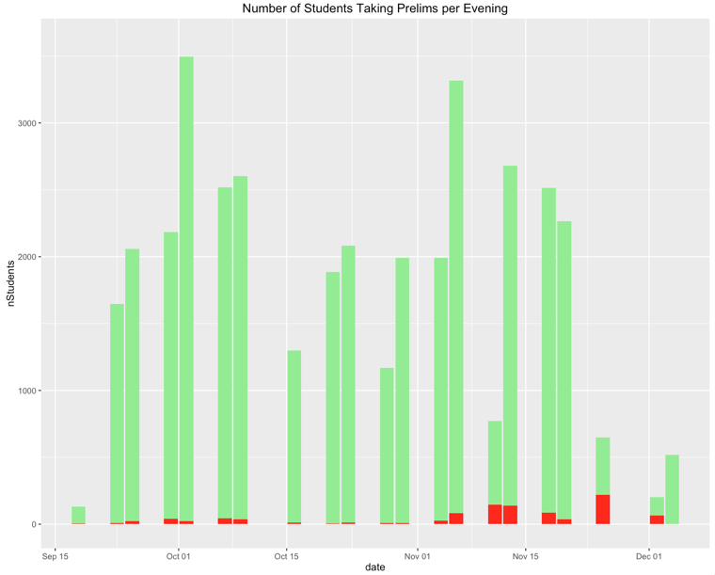
New Integer Programming Model
2014 Fall Semester with Plus/Minus One Evening (Relaxed)
Operational Research and Information Engineering

Slide 31
New Integer Programming Model
Operational Research and Information Engineering

Slide 32
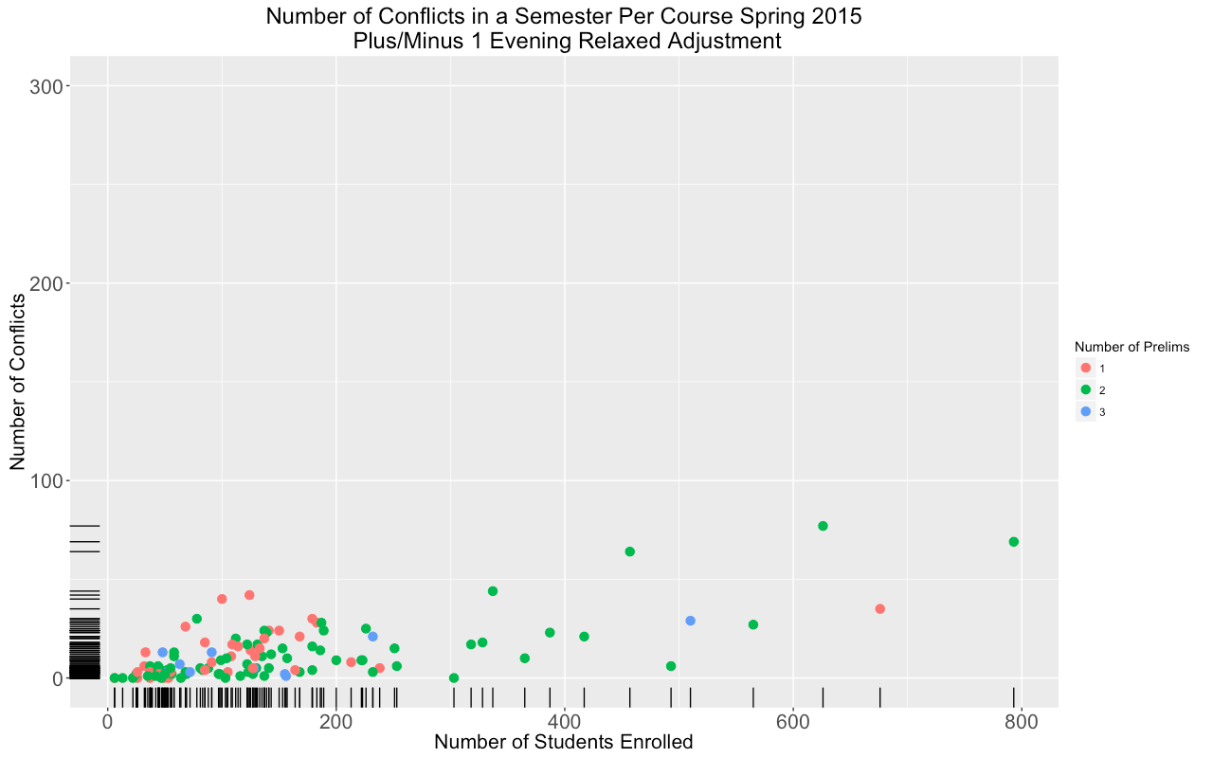
New Integer Programming Model
Operational Research and Information Engineering

Slide 33
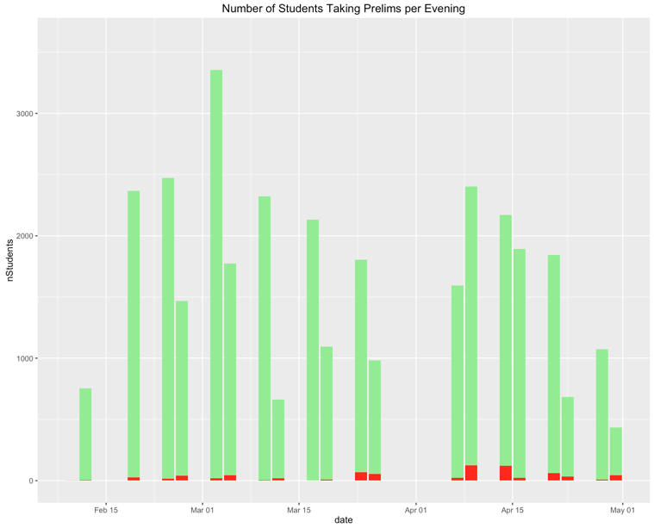
New Integer Programming Model
2015 Spring Semester with Plus/Minus One Evening (Relaxed)
Operational Research and Information Engineering

Slide 34
New Integer Programming Model
Using Survey Responses as Model Inputs
~50 responses could be used as patterns for each semester
Faculty response guaranteed on of patterns given was chosen
For courses with no faculty response, the set of configurations was the original assignment plus or minus 1 evening
Faculty who responded all had similar preferences
Operational Research and Information Engineering

Slide 35
New Integer Programming Model
Operational Research and Information Engineering

Slide 36
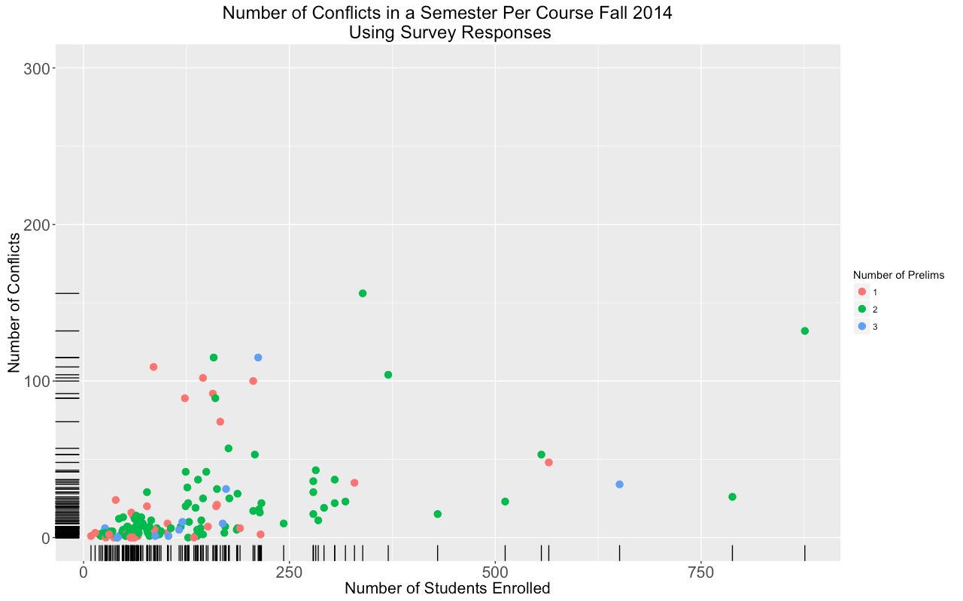
New Integer Programming Model
Operational Research and Information Engineering

Slide 37
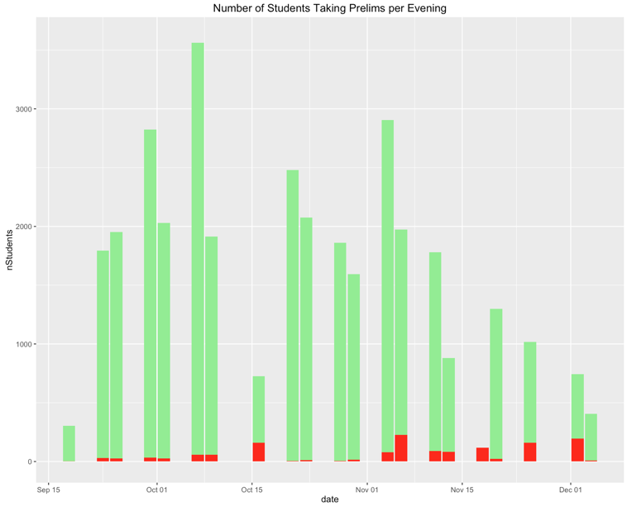
New Integer Programming Model
2014 Fall Semester with Survey Response or Plus/Minus One Evening
Operational Research and Information Engineering

Slide 38
New Integer Programming Model
Operational Research and Information Engineering

Slide 39
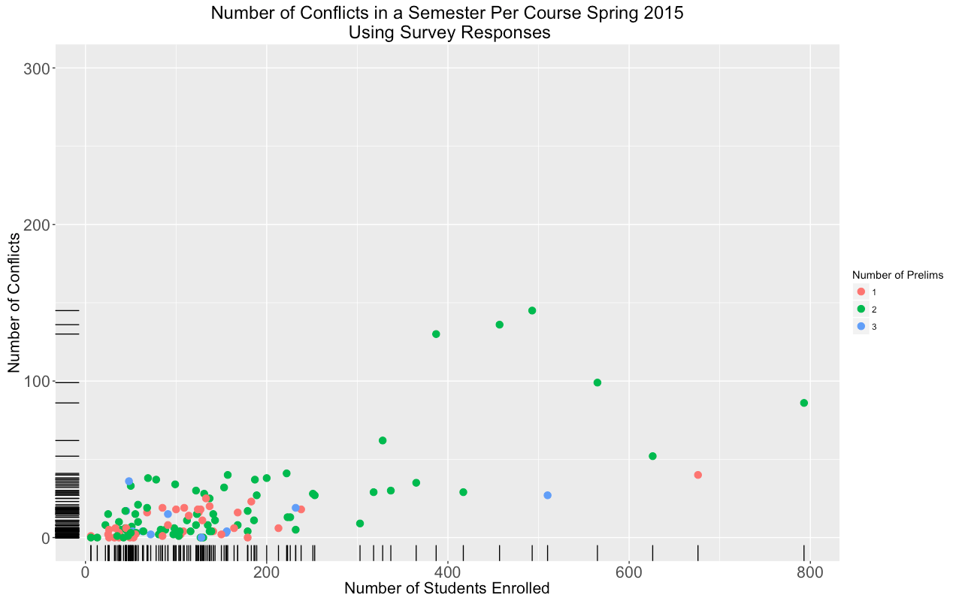
New Integer Programming Model
Operational Research and Information Engineering

Slide 40
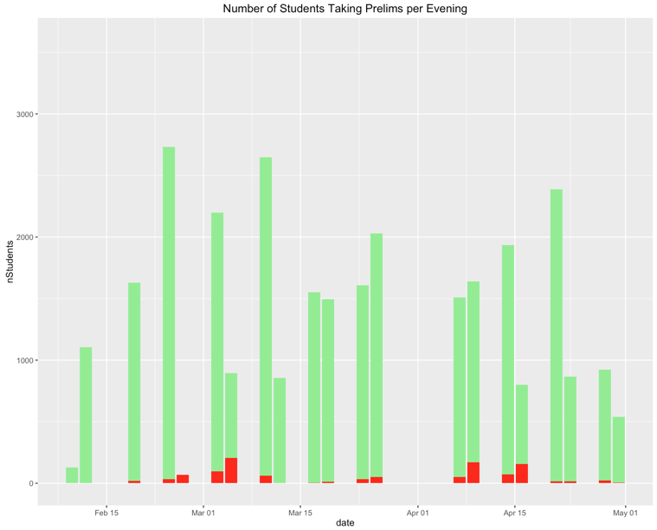
New Integer Programming Model
2015 Spring Semester with Survey Response or Plus/Minus One Evening
Operational Research and Information Engineering

Slide 41
New Integer Programming Model
Total Number of Conflicts in a Semester
 | Original | ±1 | ±1 Relaxed | Survey
Fall 2014 | 1478 | 500 | 367 | 715
Spring 2015 | 1203 | 476 | 397 | 882
Number of Conflicts per Course
 | Original |  | ±1 |  | ±1 Relaxed |  | Survey
 | Mean | Median | Mean | Median | Mean | Median | Mean | Median
Fall | 28 | 13 | 15 | 5 | 14 | 4 | 20 | 7
Spring | 21 | 12 | 13 | 8 | 11 | 6 | 17 | 8
Operational Research and Information Engineering
Notes:
use course type (C, B, W) to create course index
use data from registra to evaluate current schedule

Slide 42
New Integer Programming Model
Limitations
We have been working with end of the semester enrollments
To what extent does pre-enrollment change things?
We have been working with just two semesters of data
How has the number of conflicts changed over the years?
How much does the schedule for a course change in a year?
Need to promote diversity in preferences
Survey results suggest most faculty prefer same slots
Operational Research and Information Engineering
Notes:
use course type (C, B, W) to create course index
use data from registra to evaluate current schedule

Slide 43
New Integer Programming Model
Future Development
Integrate the data collection, data processing, optimizing and result comparing parts; design an interface for this tool.
Implementation
Incentivize professors provide their desired time slots:
Fast responses will guarantee priority when there’s conflicts.
If the professor is willing to provide a more flexible schedule, his/her course could be assigned schedule first.
Operational Research and Information Engineering

Slide 44
Q&A

Slide 45
Thank You very much

